Slide 1

Open Source Investigation
where common man becomes hacker

Slide 2
$ whoami : Lakshit Verma
Independent Security Researcher
Osint Evangelist
Freelance-Law enforcement Consultant
Founder @ We Are Plymouths Foundation
Core Member @Keycybr (Cybersecurity Co.)
Mentor Of Change @Faigaze Pvt. Ltd.
Co-ordinator @ Mission Crime Free Bharat
Under Guidance shri. Maithili Sharan DGP MP

Slide 3



“If You're Online You're Vulnerable.”

Slide 4

AGENDA
Osint
01
Practicals
02
Sources
03
Mitigations & Laws
04
What, where, why OSINT Demystifying OSINT myths
scenarios where osint can practically be applied
Sources from where data can be extracted
Preventing yourself from becoming a target

Slide 5
WHAT IS OSINT?
used in national security, law enforcement, and business intelligence
data collected from publicly available sources to be used in an intelligence context.
requires more common sense and understanding the connections
the easiest subdomain to get started with in cybersecurity

Slide 6
INTELLIGENCE GATHERING
HUMINT - MI6, IMGINT
GEOINT - satellite images
CYBINT - cyber attacks & logs
01
02
03
04
05
SIGINT - HackRF
MASINT - Nuclear, Electro-optical, Radar, Frequency, Materials

Slide 7
How OSINT Can Help Us ?
Locating Digital footprints
Performing digital investigations
Gathering information for competitive intelligence or penetration testing.

Slide 8
OSINT : What To Look For ?
Social Media
IP Addresses
Geolocation
Reverse Image Search
Phone Numbers
Leaked Documents
Vulnerable Web Servers , Devices Etc.

Slide 9


WHAT CAN I OSINT
DOMAIN
PEOPLE
OTHERS
IP
Subdomains, MX records, Ports discovery, WHOIS lookup
Name, username, email, phone number, emotions, geoloc and much more information
MAC address, images, BTC address, vehicle number
Geolocation, proxy/vpn/tor, IOT device, download history

Slide 10
WHY OSINT ?
Allows you to gather huge amounts of actionable intelligence without ever sending a packet to your target.

Slide 11
Why OSINT
Password cracking/KBA optimization/Social Engineering:
● pet name
● year of birth
● significant other/relatives names
● place of birth
● favorite food
● where they were married
● previous addresses
● previous employers
● list of schools
● year account or mortgage was opened

Slide 12
People OSINT Approach
Start with what you know (email, username, etc.)
Define requirements (what you want to get)
Gather the data
Analyze collected data
Pivot as-needed using new gathered data
Validate assumptions
Generate report

Slide 13
Who Is Interested In OSINT ?
Govt.
International Organisation
National Security Agencies (CBI , FBI , CIA)
Law Enforcement Agencies
Private Investigators
Criminals/Terrorists
Red Teamers (Pentesters , Researchers)

Slide 14
Terminologies :
Metadata & Use Of Metadata In Osint ?
Metadata : data Supporting the main data , Information Gathering & Forensics
SOCMINT is a subset of OSINT that concentrates on data gathering and monitoring on social media platforms.

Slide 15
Lets Take An Example :)

Slide 16
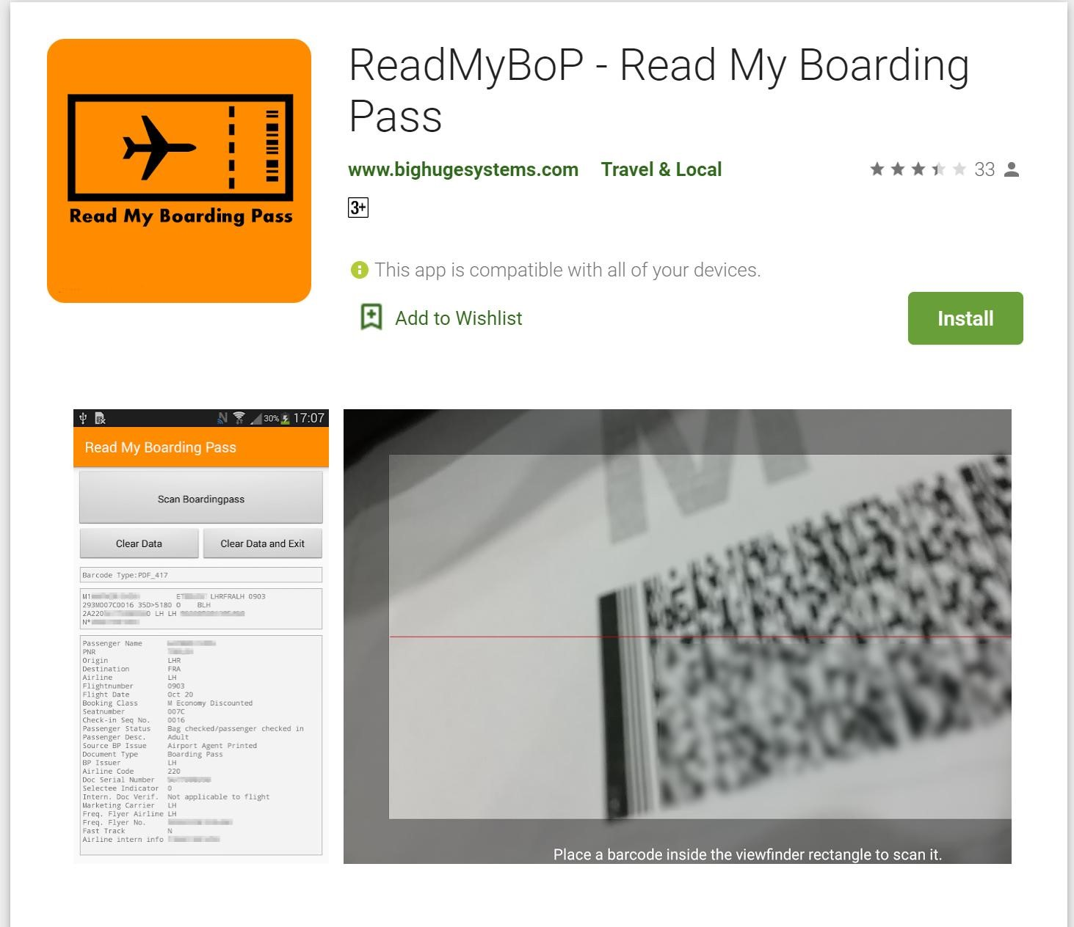

Slide 17
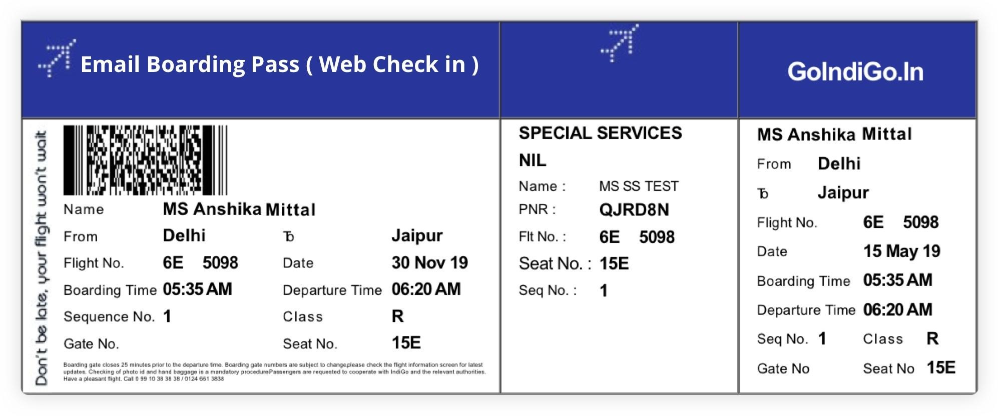

Slide 18
Boarding Pass Can Help Can Get You ?
Gender
Which passenger number in the ticket
Passenger Last name
Passenger First name
Ticket Type (Online/Physical)
PNR
Source
Destination
Flight Carrier
Flight Number

Slide 19
Boarding Pass Can Help Can Get You ?
Passenger Seat Class
Seat Number
Flight Sequence Number
Passenger Clearance Status
Passenger Checked IN/Not
document type
Where this document was printed at airport or somewhere else
Flight Date
Document issuing Flight company
Document is authorised or not

Slide 20



PEOPLE OSINT
Name
High priority input if the person is famous
Username
High priority input if the person is an average internet user
Phone number
High priority input if the person is a ghost

Slide 21
PEOPLE OSINT
Email
High priority input if you wanna get access to the target
Image
Low priority input unless you have really good image analysis skills
Date Of Birth
Low priority input but unique factor for the search

Slide 22
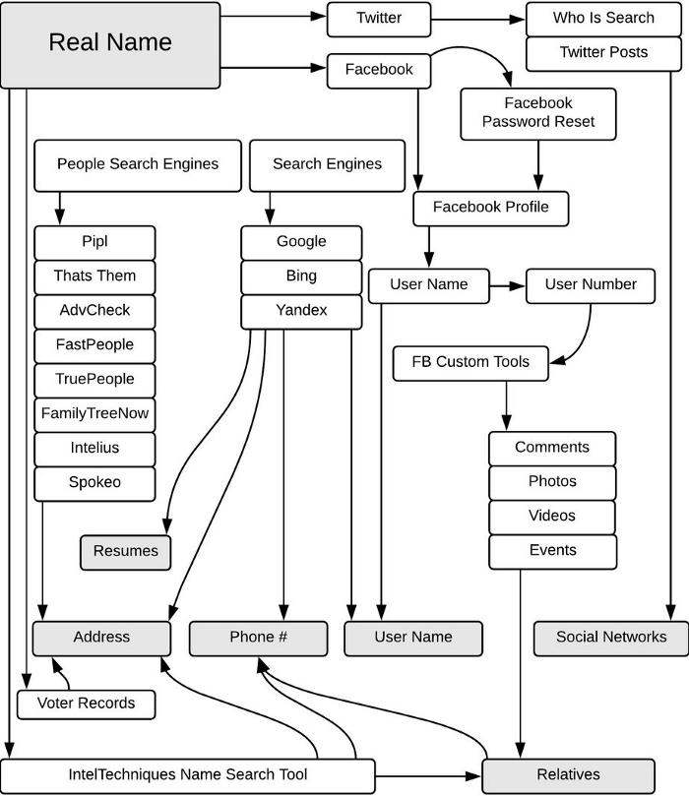

Slide 23

NAME
Search Engines
Customised search engines, google dorks
People Search
Inclined towards foreign nationals
Govt Portals
Voter ID, Electoral Rolls

Slide 24
DORKS
Operators :
inurl - www.example.com/adithyan+ak
intitle
intext
filetype
site
Format :
operator : “data”
Ex : inurl : “acelakshitverma” | you can combine dorks too
No space

Slide 25
CUSTOM SEARCH ENGINES
Pre-Configured - https://cse.google.com/cse?cx=005553992128112222999:w1eonxpepby
Create your own - https://programmablesearchengine.google.com/about/

Slide 26
People Search
Google
Bing - https://www.bing.com/
DuckDuckGo - https://duckduckgo.com/
Yandex - https://yandex.com/
Voter Information - https://electoralsearch.in/

Slide 27
USER NAME
Search Engines
Leveraging search engines to construct list of possible usernames
Social Networks
Directly searching in social networks for undiscoverable accounts
Username
Narrow Down
Narrow down approach in search engines

Slide 28
Username
Check Usernames - https://checkusernames.com/
Instant Usernames - https://instantusername.com/
User search - https://usersearch.org/
Whats my name - https://whatsmyname.app/
Search POF - https://searchpof.com/
https://twitter.com/search-advanced
https://www.trendsmap.com/

Slide 29
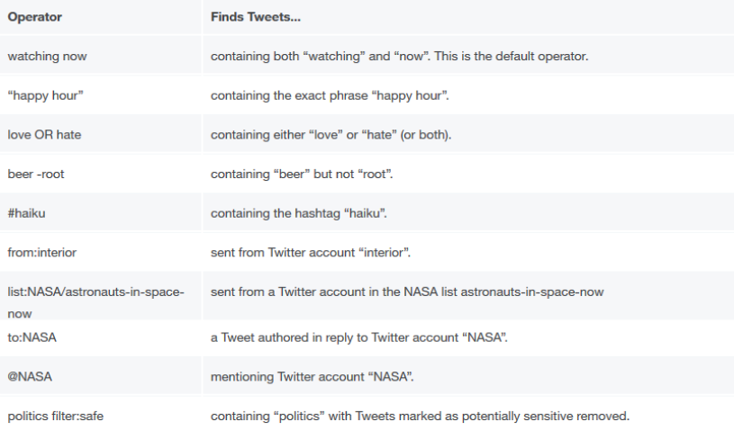
Twitter

Slide 30
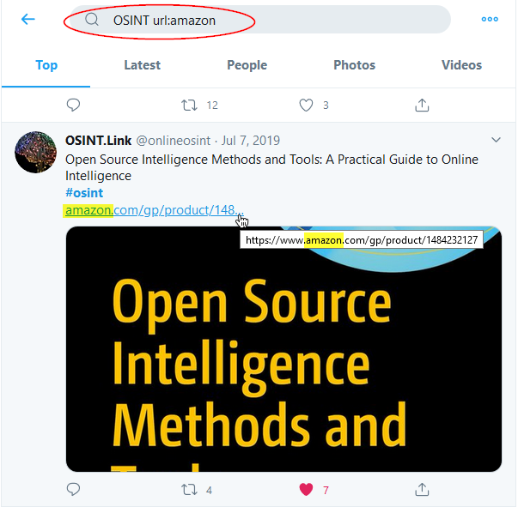
Twitter

Slide 31
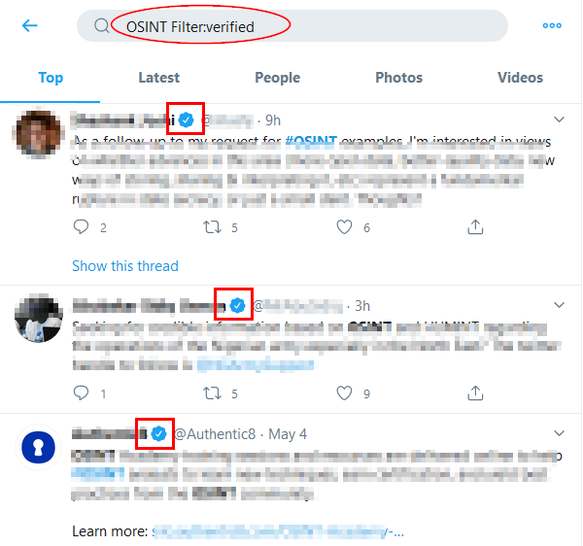
Twitter

Slide 32
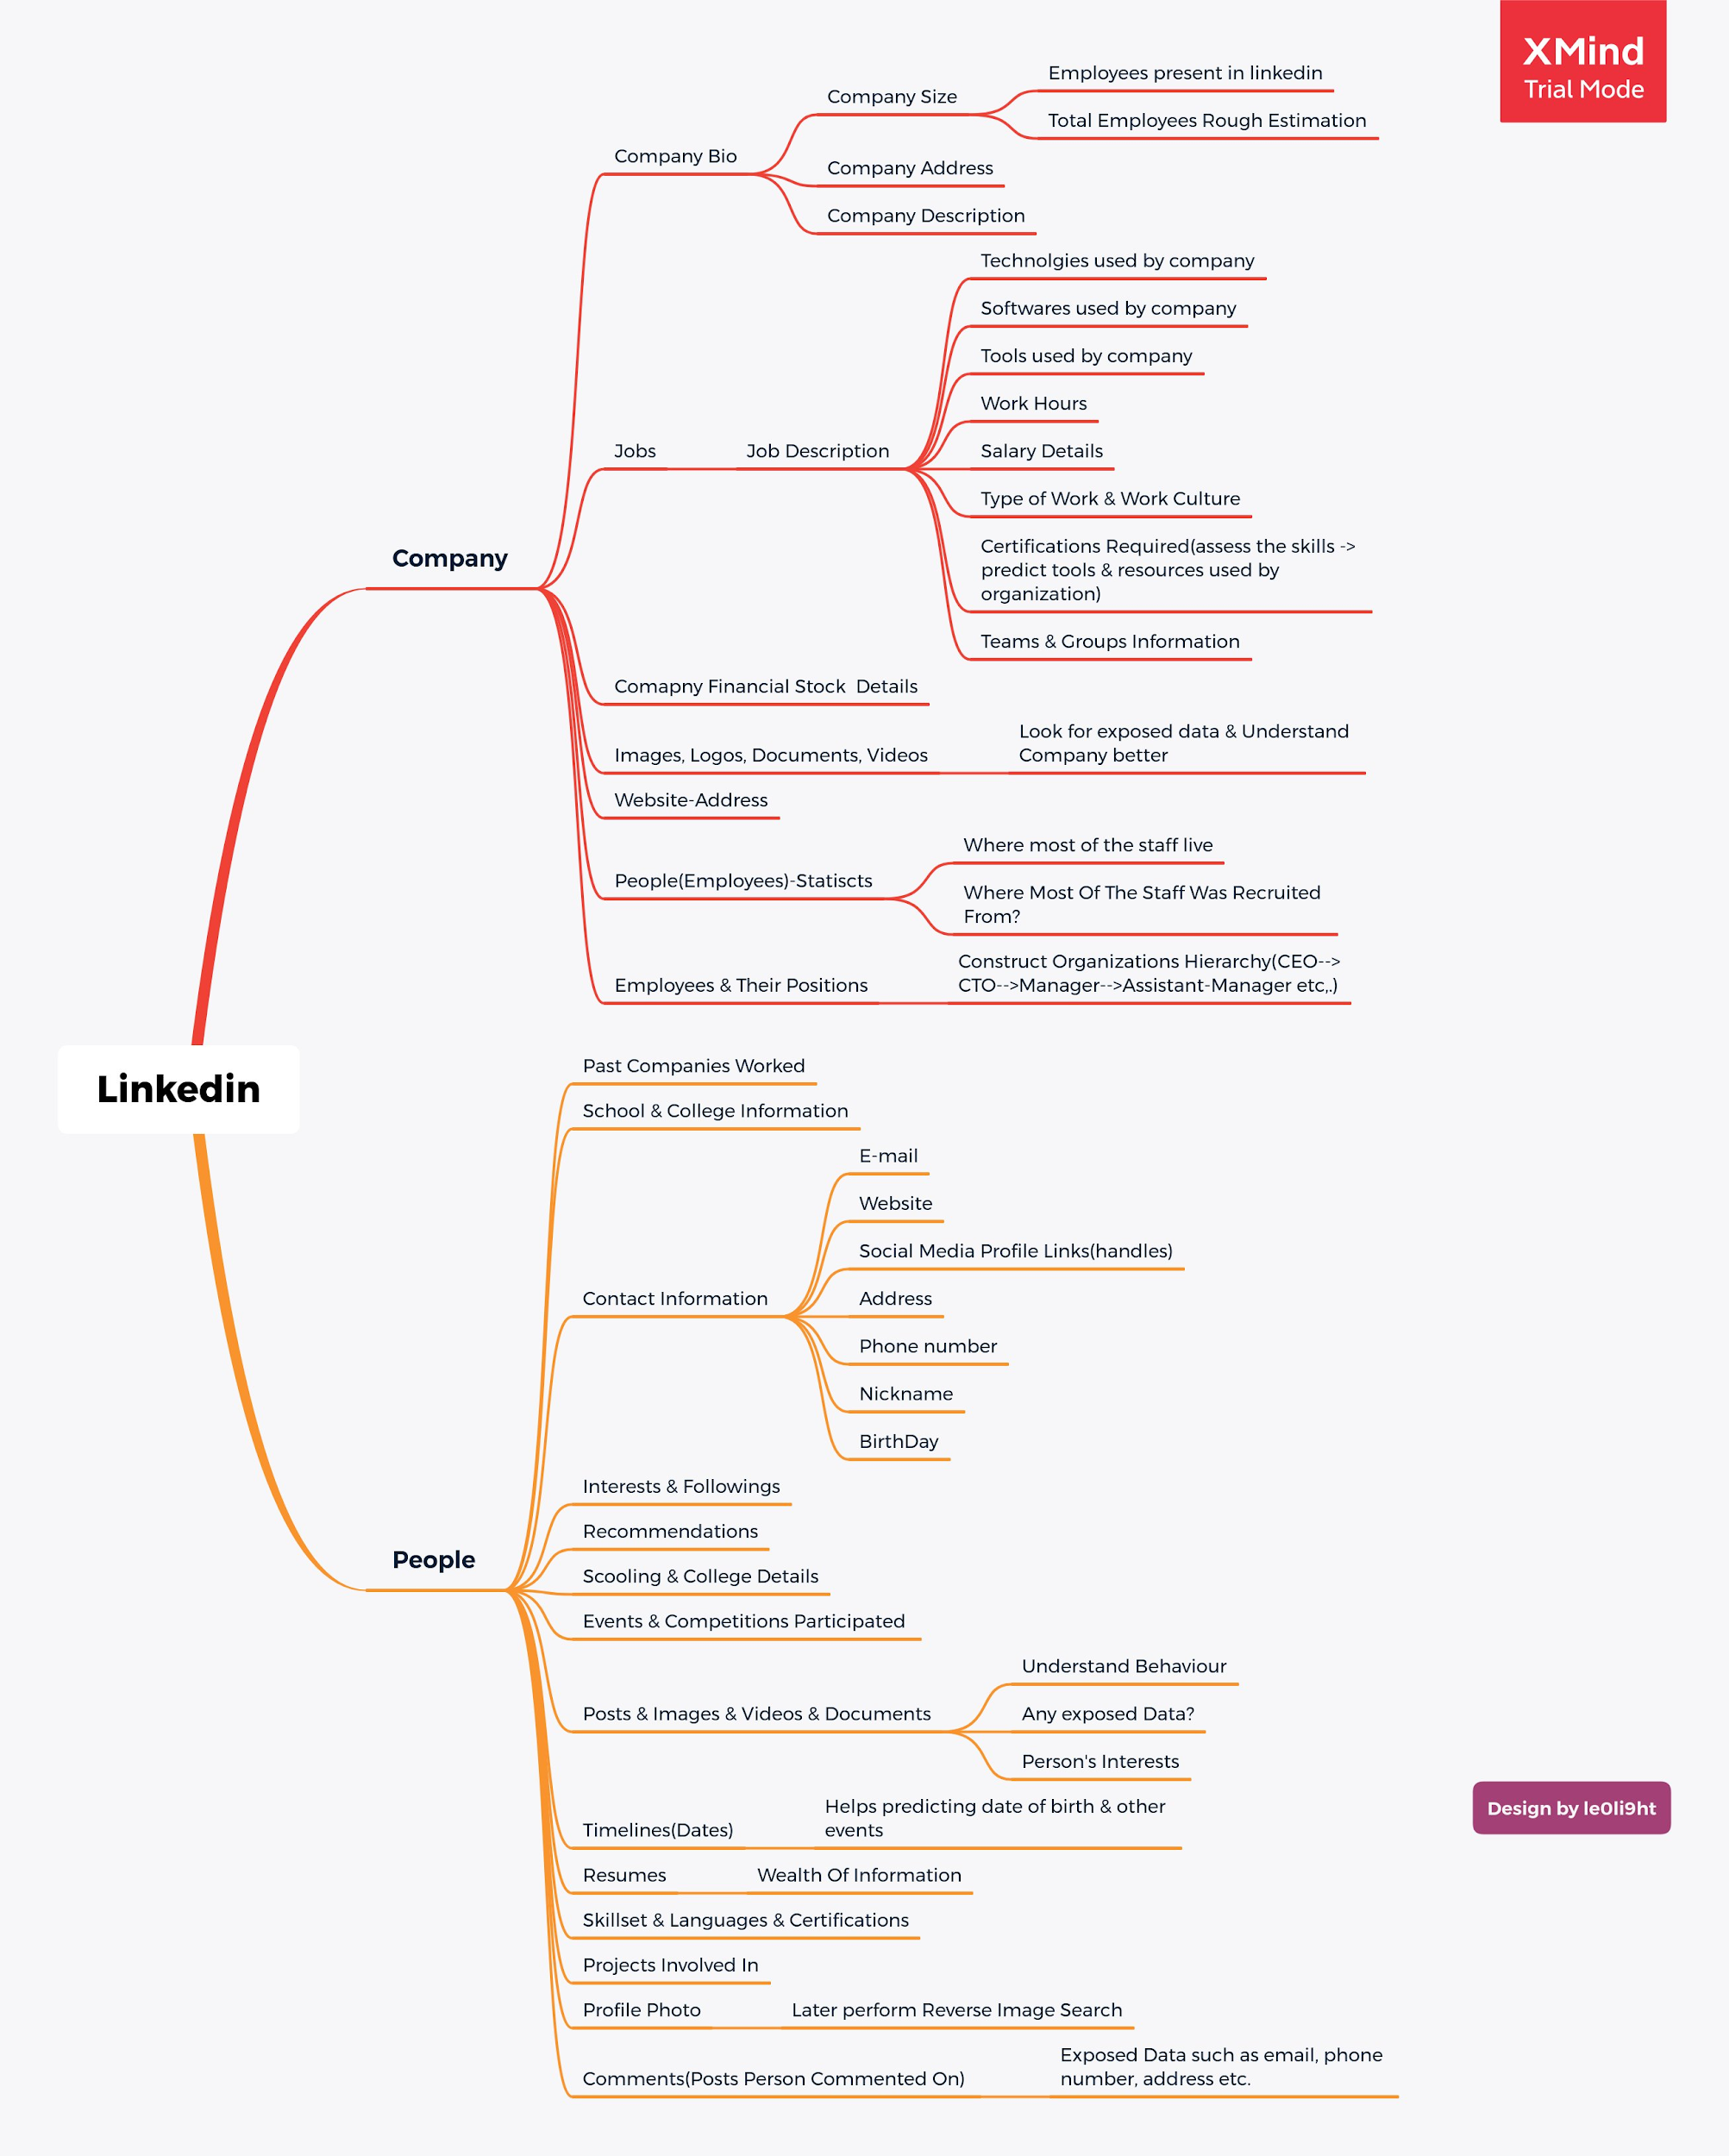

Slide 33
Phone Number
Truecaller
GetContact
HLR Lookup - https://www.free-hlr.com/
Numverify - https://numverify.com/
Google password reset

Slide 34
Email
Email Permutations - http://metricsparrow.com/toolkit/email-permutator/
Email Rep - https://emailrep.io/
Hunter.io - https://hunter.io/
Ghostproject - https://ghostproject.fr/
Myrz - http://myrz.org

Slide 35
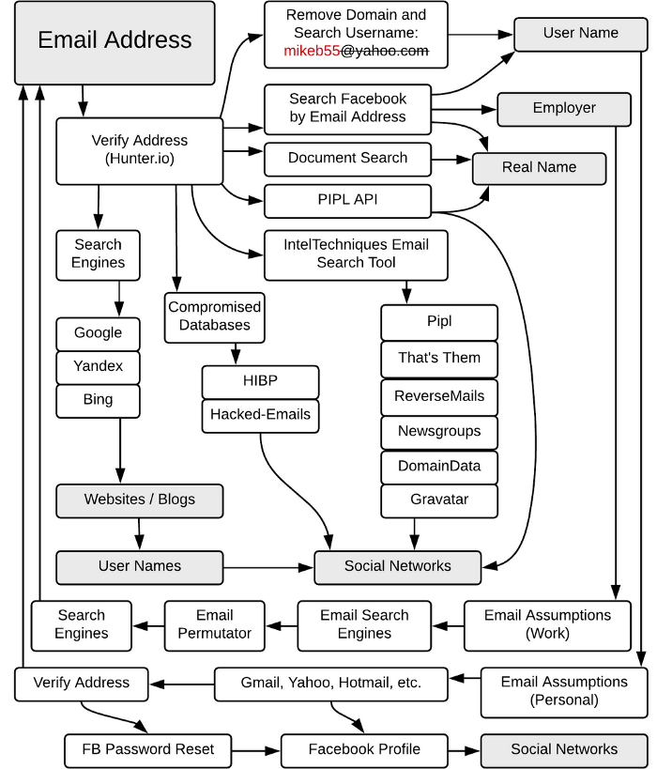

Slide 36
Image
Reverse image search - https://www.duplichecker.com
Metadata - https://www.pic2map.com | EXIF Tool
Common sense analysis

Slide 37
Domain
Whois - https://whois.domaintools.com/
NSlookup - https://mxtoolbox.com/DnsLookup.aspx
MX Lookup - https://mxtoolbox.com
Wappalyzer
Web Archive - https://archive.org/
Sublister - https://github.com/aboul3la/Sublist3r
Virustotal - https://www.virustotal.com/gui/home/url
What CMS - https://whatcms.org

Slide 38
IP
Shodan
Censys
IP API - https://ipapi.co
Ip2Location
ip2proxy

Slide 39
Misc
Emotions - https://tone-analyzer-demo.ng.bluemix.net/
Vehicle - https://vahan.nic.in/nrservices/faces/user/searchstatus.xhtml
Google Hacking Database - https://www.exploit-db.com/google-hacking-database
Camera - http://www.insecam.org/
People via camera - http://snradar.azurewebsites.net/
MAC Address

Slide 40
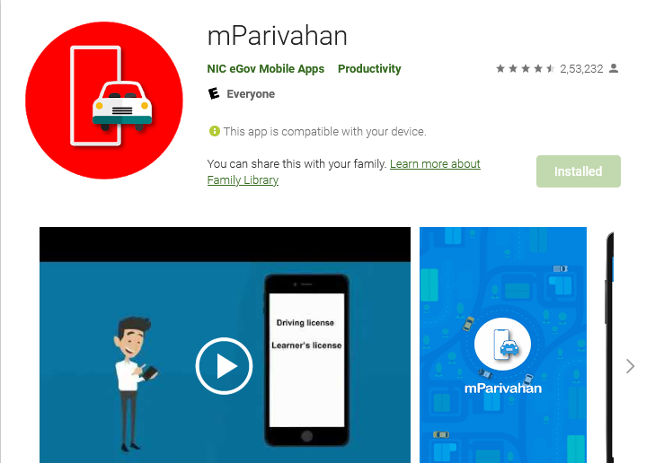
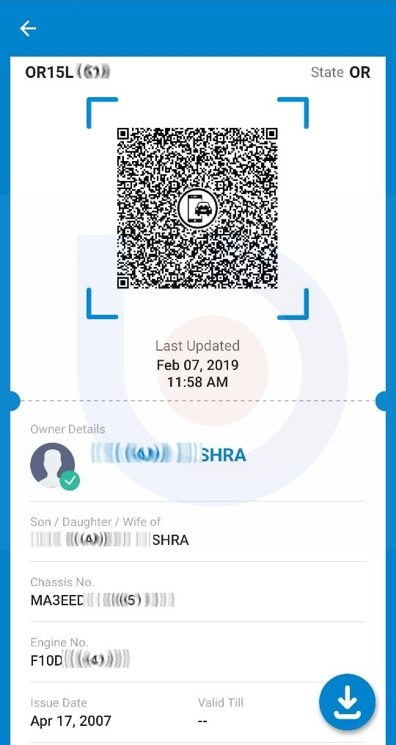
VEHICLE DATA EXTRACTION

Slide 41
Famous OSINT Tools
https://intelx.io/tools
https://www.aware-online.com/osint-tools/
Maltego
Spiderfoot

Slide 42
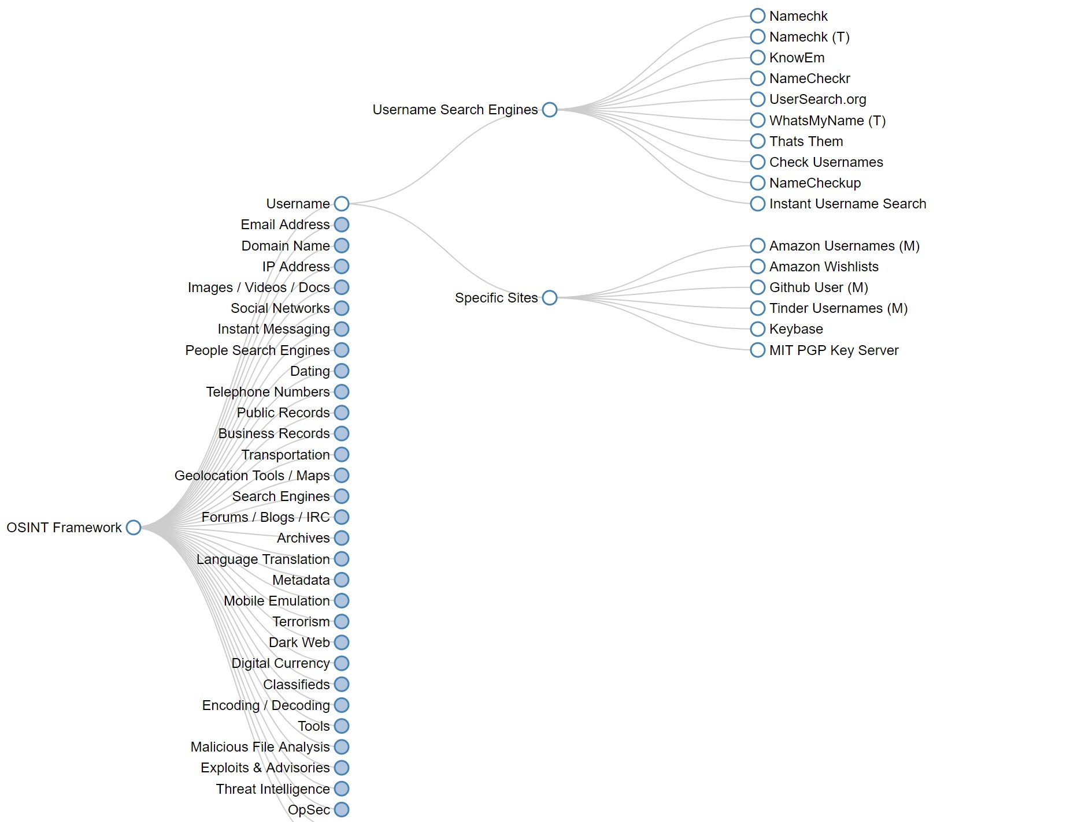
Osintframework.com

Slide 43
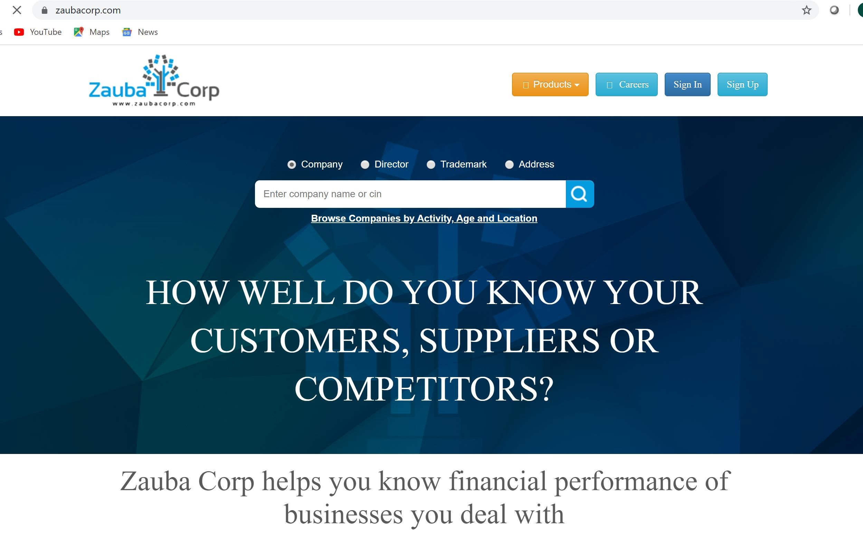
Zaubacorp.com

Slide 44
Careers In OSINT ?
Financial Research
National Security Agencies (CBI , FBI , CIA)
Law Enforcement Agencies (LEA)

Slide 45

LEGAL ?
OSINT is 100% legal until you don't cross certain limits.
Impersonation
Social Engineering
Buying breached data from dark web
Stalking someone with malicious intent

Slide 46

THANKS
Does anyone have any questions?
acelakshitverma@gmail.com
facebook.com/acelakshitverm
@acelakshitverma
akinfosec
acelakshitverma

